Slide 1
Organometallic Chemistry
Gary O. Spessard
Gary L. Miessler

Slide 2
Contents
1 . Overview of Organometallic Chemistry
1-1 Striking Difference
1-2 Historical Background
2 . Fundamentals of Structure and Bonding
2-1 Atomic Orbitals
2-2 Molecular Orbitals
3 . 18-Electron Rule
3-1 Counting Electrons
3-2 Why 18 Electrons?
3-3 Square Planar Complexes

Slide 3
4 . Carbonyl Ligand
4-1 Bonding
4-2 Binary Carbonyl Complexes
4-3 Oxygen-Bonded Carbonyls
4-4 Ligands Similar to CO
4-5 Infrared Spectra
4-6 Main Group Parallels with Binary Carbonyl Complexes
5 . Pi Ligands
5-1 Linear Pi Systems
5-2 Cyclic Pi Systems
5-3 NMR Spectra of Organometallic Compounds
6 . Other Important Ligands
6-1 Complexes Containing M-C,M=C,M=C bonds
6-2 Hydride and Dihydrogen Complexes
6-3 Phosphines and Related Ligands

Slide 4
7. Organometallic Reactions Ⅰ: Reactions That Occur at the Metal
7-1 Ligand Substitution
7-2 Oxidative Addition
7-3 Reductive Elimination
8 . Organometallic Reactions Ⅱ: Reactions Involving Modification of Ligands
8-1 Insertion and Deinsertion
8-2 Nucleophilic Addition to the Ligand
8-3 Electrophilic Reactions
9 . Homogeneous Catalysis : Use of Transition Metal Complexes in Catalytic Cycles
9-1 Fundamental Concepts of Homogeneous Catalysis
9-2 Hydroformylation Reaction
9-3 Wacker-Smidt Synthesis of Acetaldehyde
9-4 Hydrogenation
9-5 Monasanto Acetic Acid Process
9-6 Future Directions for Trransition Metal Catalysis

Slide 5
10 . Transition Metal-Carbene and Transitionn-Metal Carbyne Complexes : Structure, Preparation,and Chemistry;Metathesis and polymerization Reactions
10-1 Structure of Metal-Carbene Complexes
10-2 Synthesis of metal-Carbene Complexes
10-3 Reactions of Metal-Carbene Complexes
10-4 Metal-Carbyne Complexes
10-5 Metathesis
10-6 Ziegler-Natta Polymerization of Alkenes
10-7 Sigma (σ) Bond Metathesis
11 . Applications of Organometallic Chemistry to Organic Synthesis
11-1 Enantioselective Functional Group Introconversions
11-2 Organotransition Metal Complexes as Protrcting and Activating Group
11-3 Carbon-Carbon Bond Formation via Carbonyl and Alkene Insertion
11-4 Carbon-Carbon Bond Formation through Cyclization Reactions

Slide 6
12 . Isolobal Groups and Cluster Compounds
12-1 Isolobal Analogy
12-2 Cluster Compounds
13 . Other Applications of Organometallic Chemistry: Bioorganometallic Chemistry, Organolanthanide Chemistry, Solid-State and Surface Chemistry, and Fullerene-Metal Complexes
13-1 Bioorganometallic Chemistry
13-2 Organolanthanide Chemistry
13-3 Surface Organometallic Chemistry
13-4 Fullerene-Metal Complexes

Slide 7
1
Overview of
Organometallic Chemistry

Slide 8
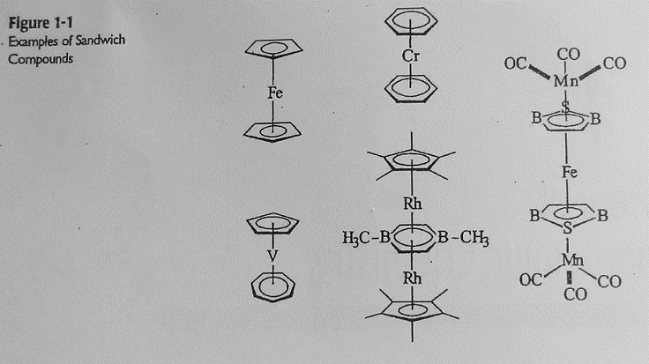
1-1 Striking Difference

Slide 9
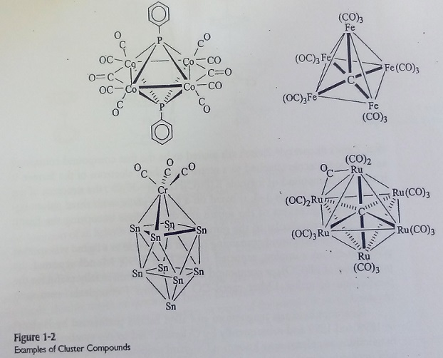

Slide 10
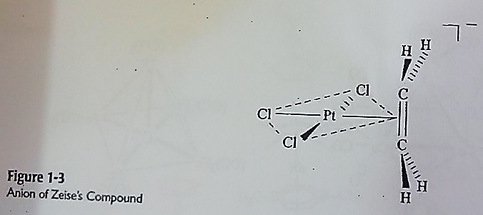
1-2 Historical Background

Slide 11
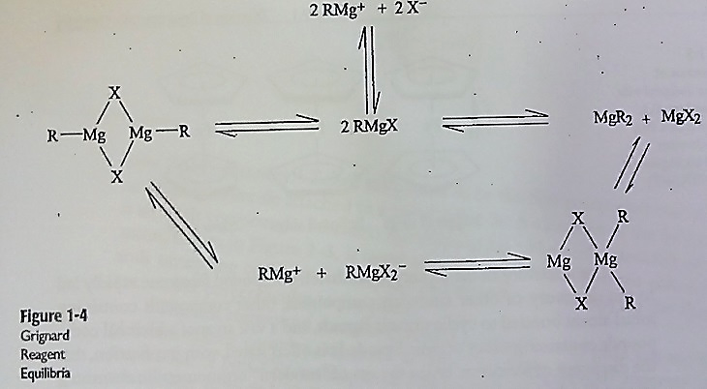

Slide 12
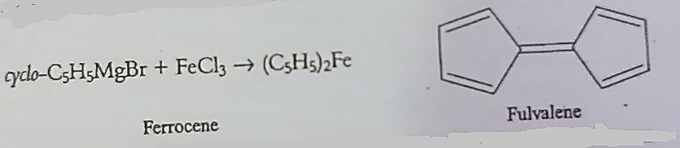
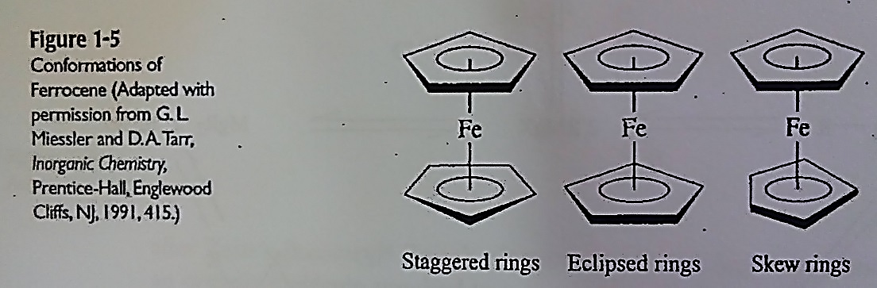

Slide 13
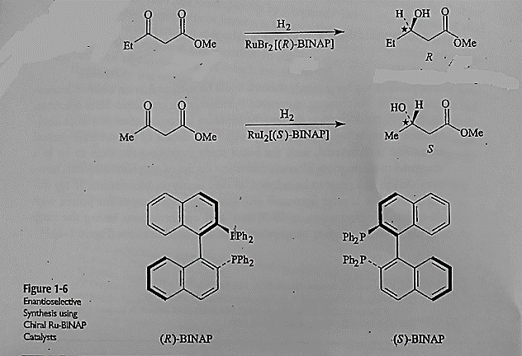

Slide 14
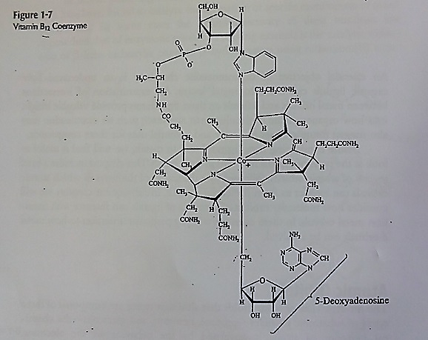

Slide 15
2
Fundamentals of Structure and Bonding

Slide 16
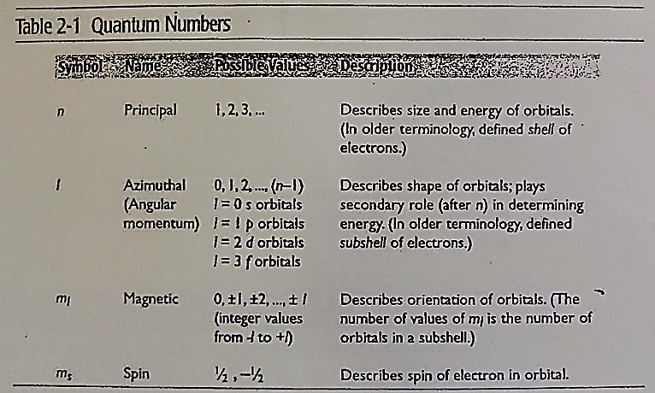
2-1 Atomic Orbital

Slide 17
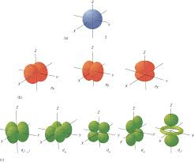
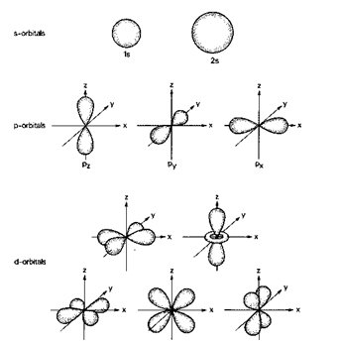
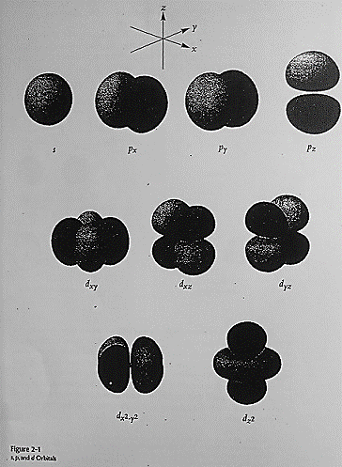

Slide 18
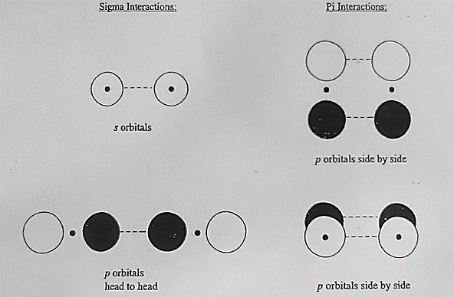

Slide 19
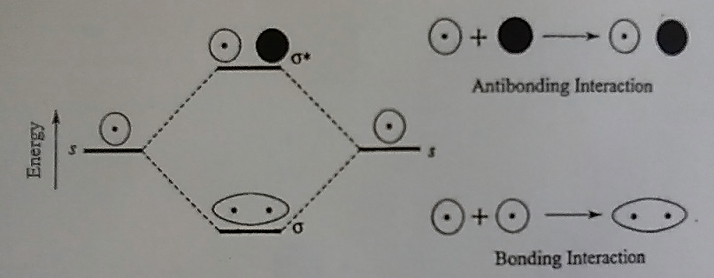
2-1-1 Sigma Interactions

Slide 20
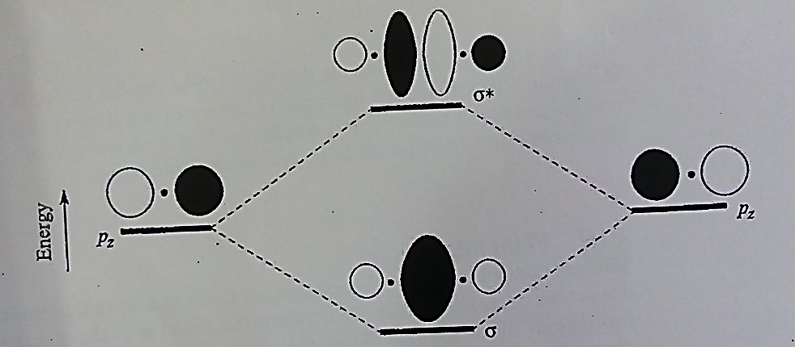

Slide 21
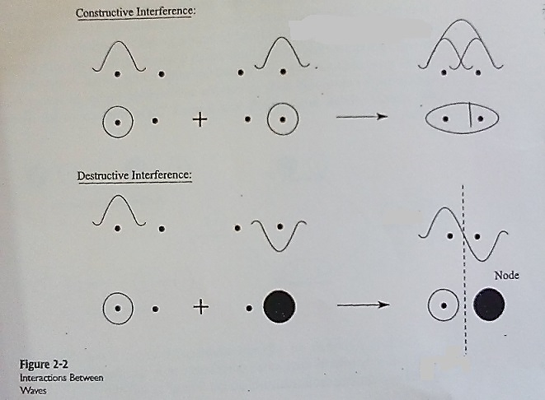

Slide 22
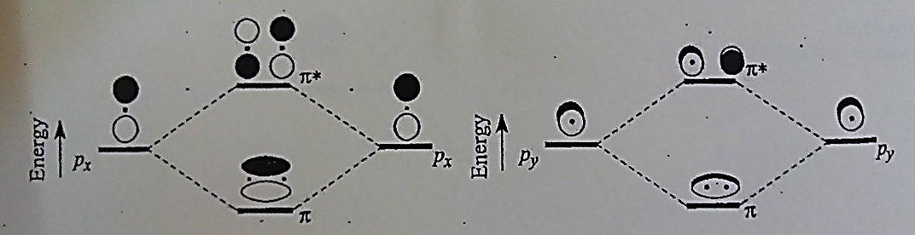
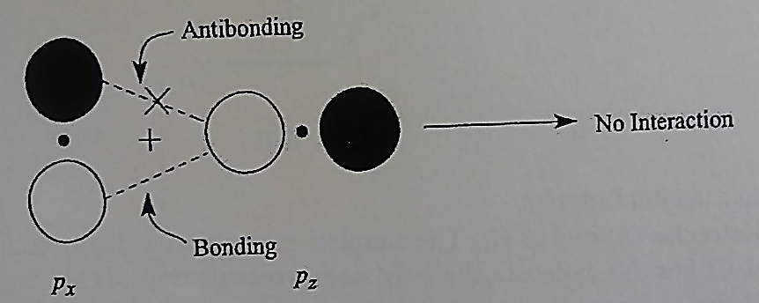
2-1-2 Pi Interaction

Slide 23
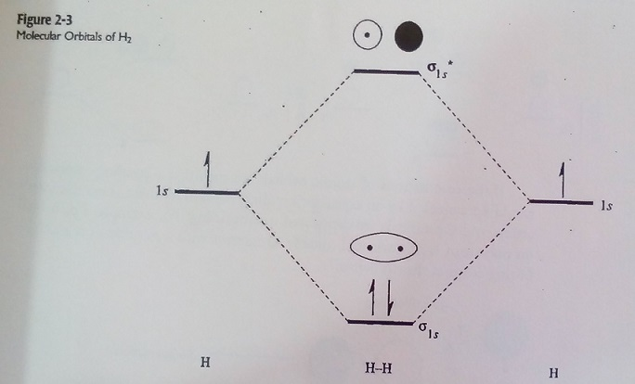
2-2 Molecular Orbitals
2-2-1 Diatomic Molecules

Slide 24
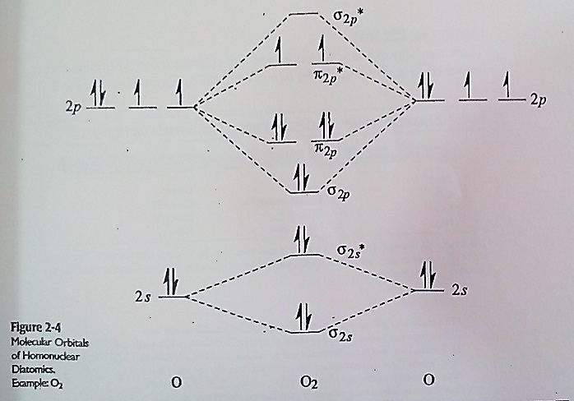

Slide 25
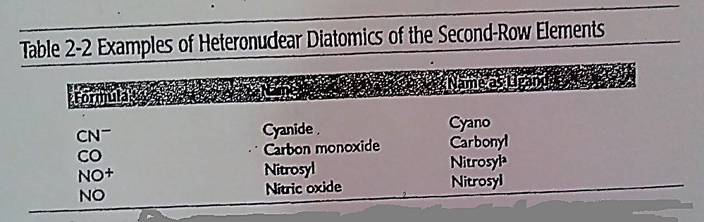

Slide 26
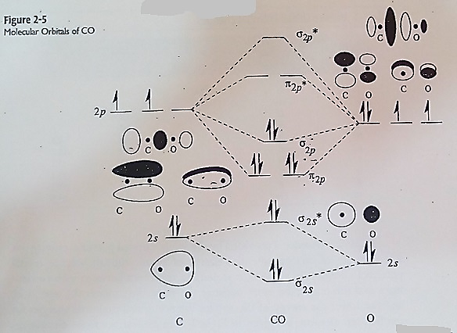

Slide 27
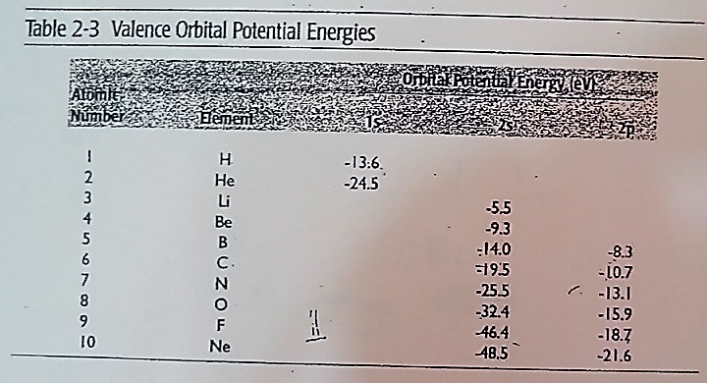

Slide 28
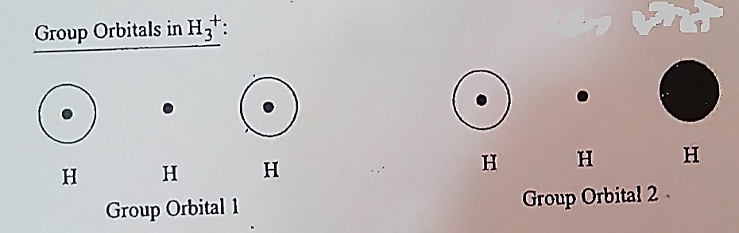
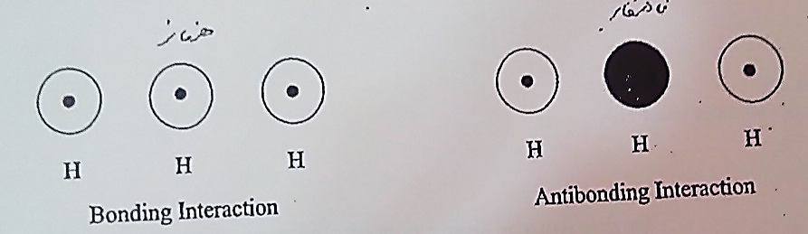
2-2-2 polyatomic Molecules: The Group Orbital Approach

Slide 29
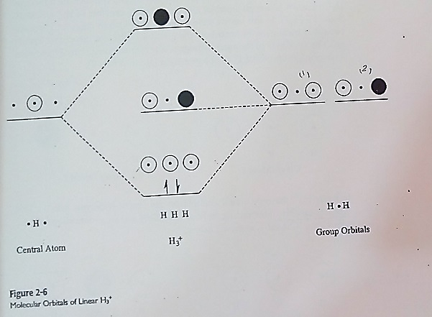

Slide 30
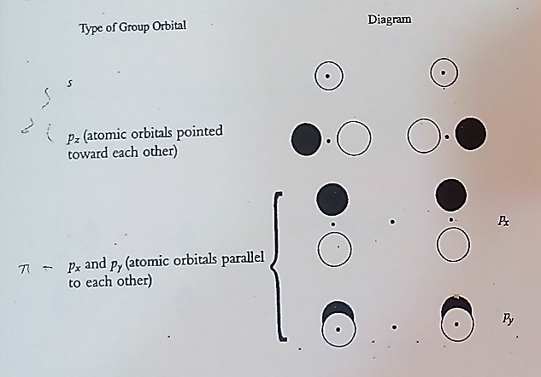

Slide 31
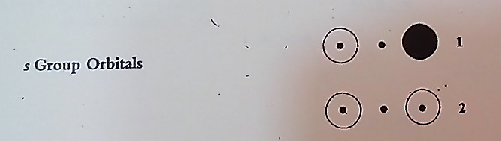
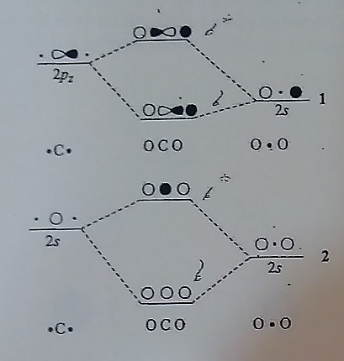

Slide 32
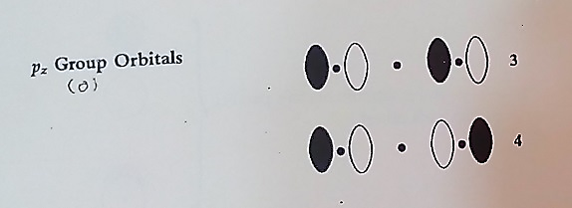
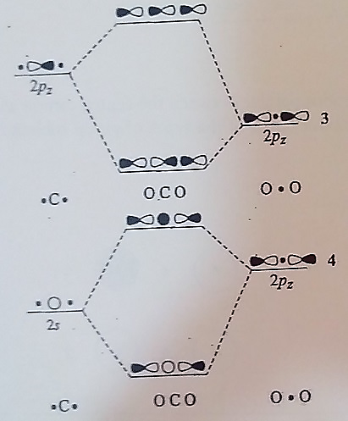

Slide 33
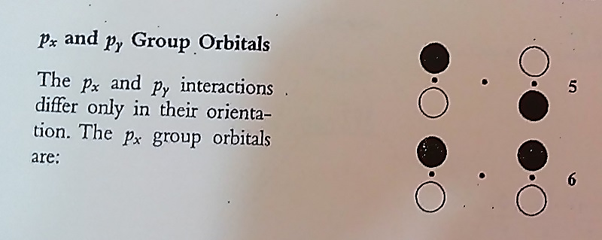
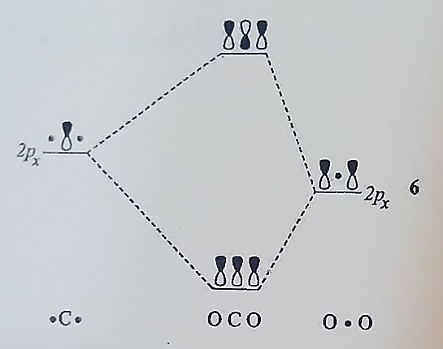

Slide 34
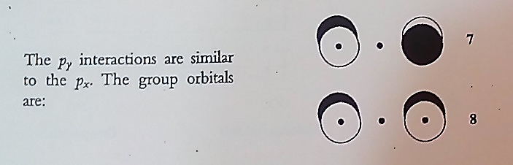
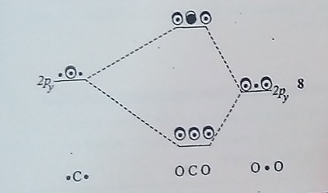

Slide 35
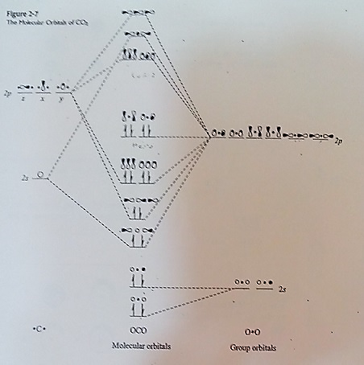

Slide 36
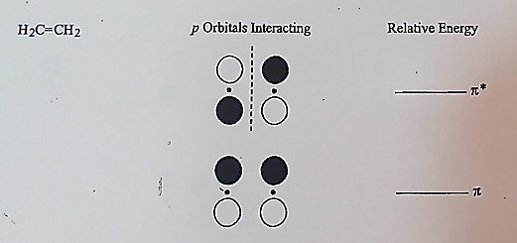
2-2-3 Ligands Having Extended Pi Systems

Slide 37
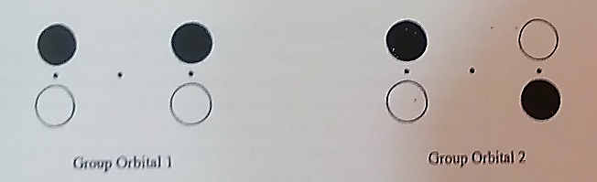
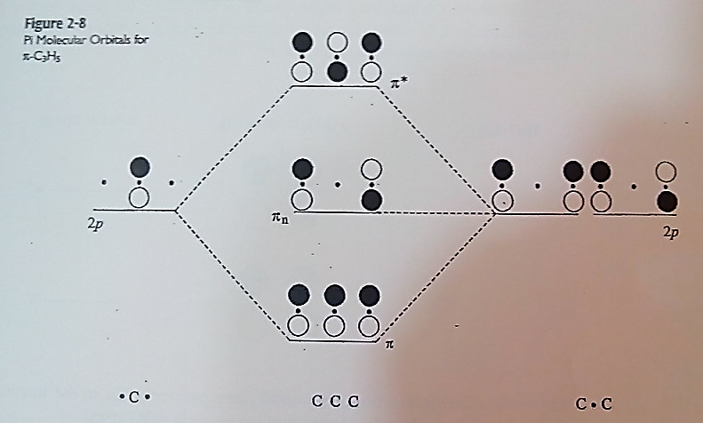

Slide 38
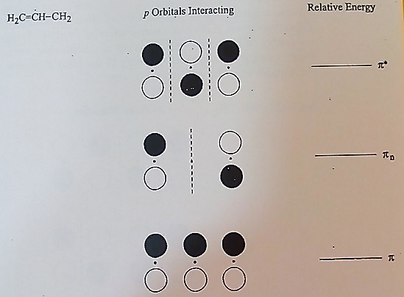

Slide 39
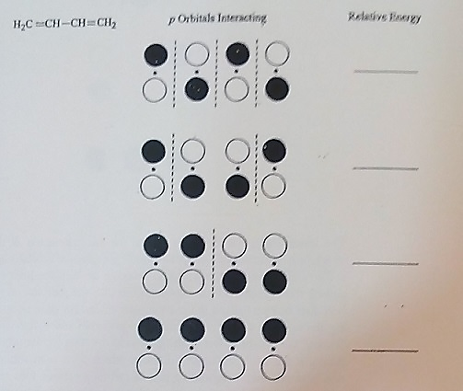

Slide 40
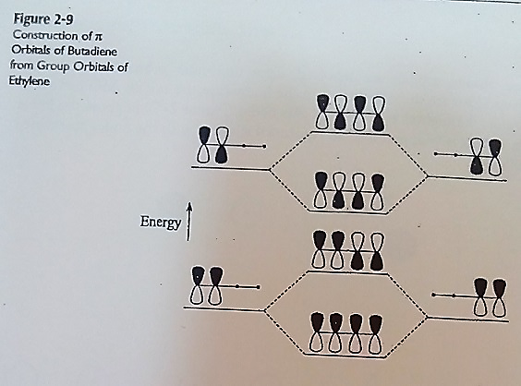

Slide 41
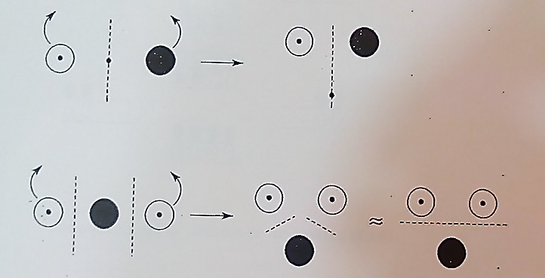
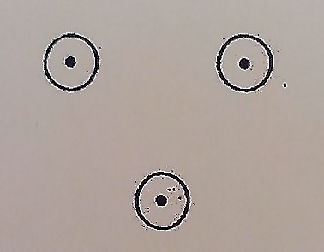
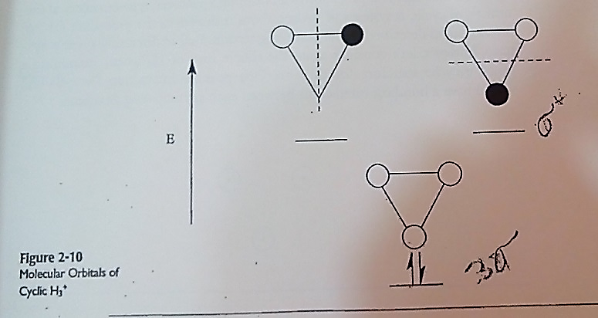

Slide 42
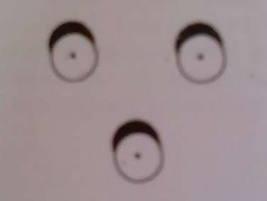
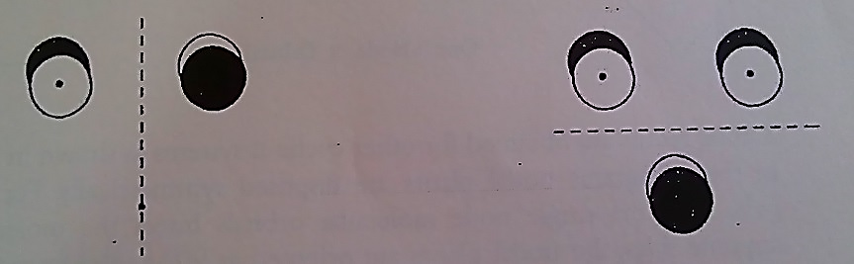
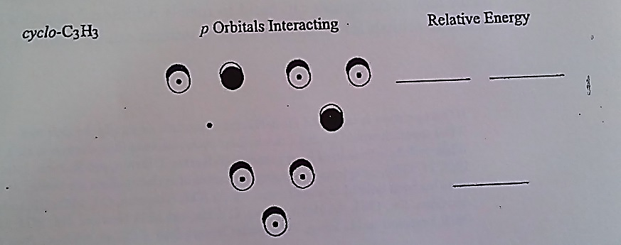

Slide 43
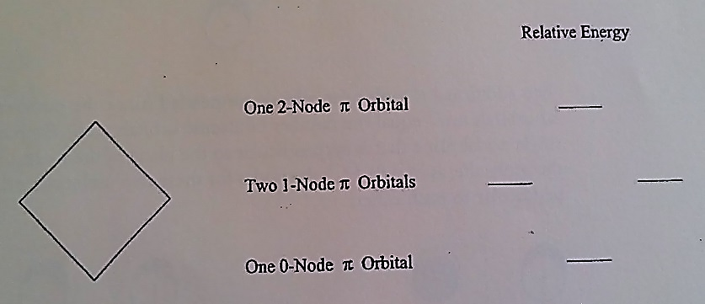

Slide 44
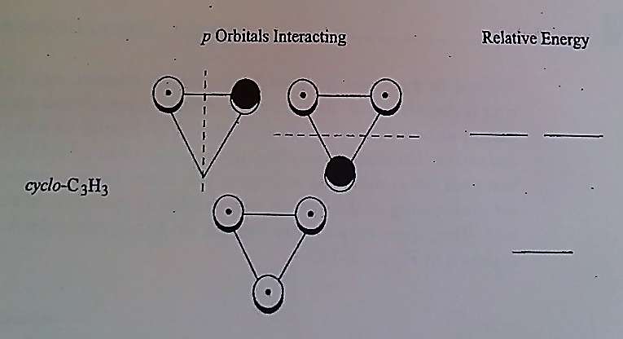



Slide 45


Slide 46
3
18-Electron Rule

Slide 47


3-1 Counting Electrons
3-1-1 Method A: Donor Pair method

Slide 48

3-1-2 Method B : Neutral Ligand Method

Slide 49


Slide 50


3-2 Why 18 Electrons?
3-2-1 Types of Metal-Ligand Interactions
σ- donor Ligands

Slide 51


Π-donor

Slide 52



Π-Acceptor

Slide 53



Slide 54

3-2-2 Molecular Orbitals and the 18-Electron Rule

Slide 55


Slide 56


Slide 57


Slide 58


Slide 59

3-3 Square Planar Complexes

Slide 60


